Slide 1
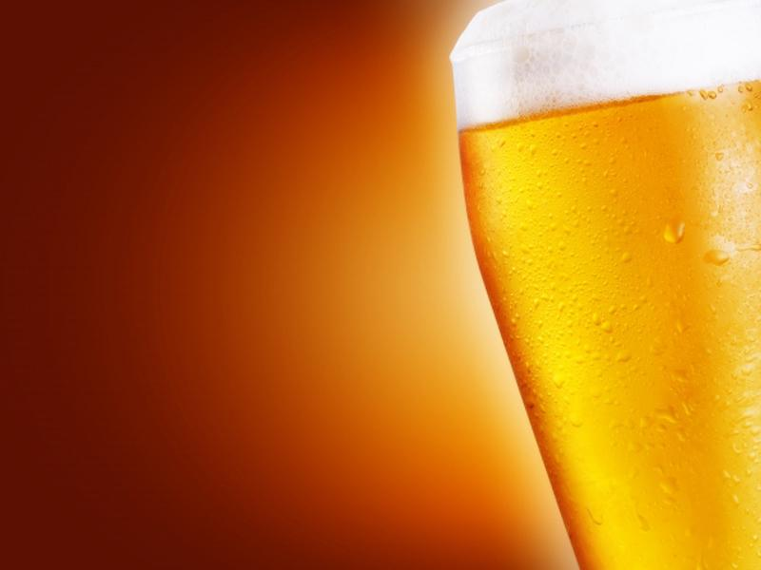
BeerVana Consulting
US Beers and Breweries
Christopher Morgan,
Dmitry Andreev,
& Eduardo Cantu
Free Powerpoint Templates

Slide 2
Data Description
Beers.csv – Dataset of 2410 craft beers
Field Name | Field Description
Name: | Name of the beer
Beer ID: | Unique indentifier of the beer
ABV: | Alcohol by volume of the beer
IBU: | International Bitterness Units of the beer
Brewery ID: | Brewery id associated with the beer
Style: | Style of the beer
Ounces: | Ounces of beer
Breweries.csv – Dataset of 558 US craft breweries
Field Name | Field Description
Brew ID: | Unique identifier of the brewery
Name: | Name of the brewery
City: | City where the brewery is located
State: | U.S. State where the brewery is located

Slide 3
Data Cleaning

Slide 4
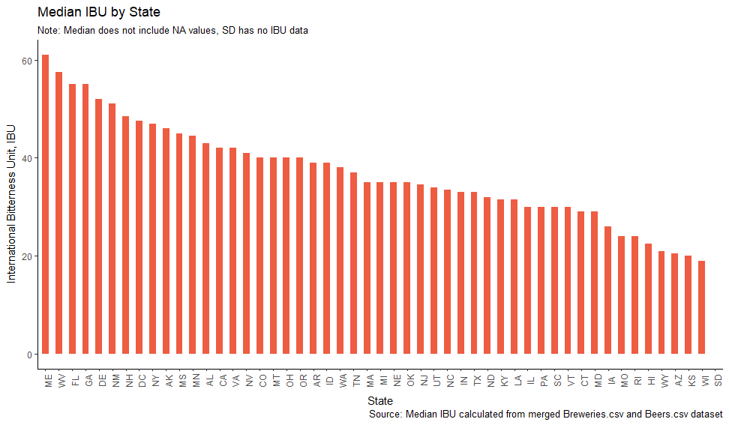
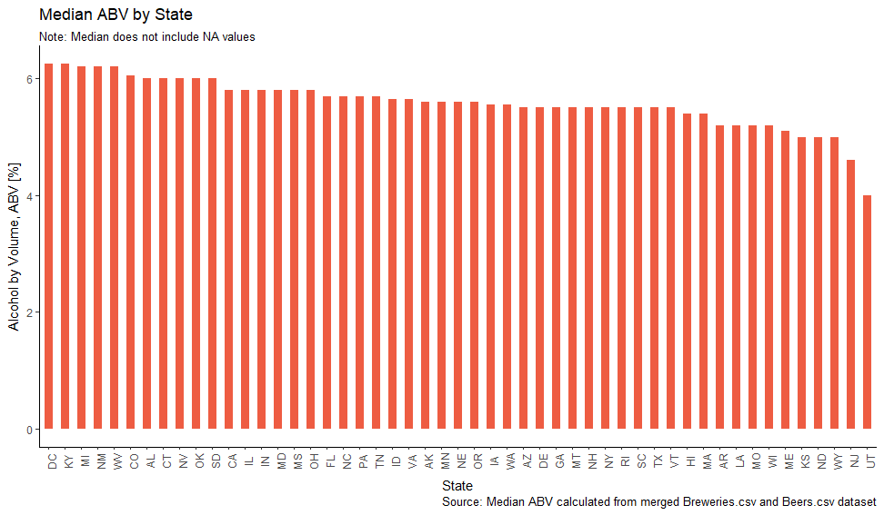


How Does Each State Compare?
International Bittering Units
Alcohol by Volume
Maine crafts beers with some of the highest IBU, mostly IPA.
For Wisconsin, even though it suggests the production of Low IBU, this can be skewed by the amount of missing values of IBU in its beers.
DC
Kentucky
Utah
6 % Alcohol
4 % Alcohol
Notes:
Kentucky
Approximately 39 counties in the state (mostly eastern and southern counties) are dry, all alcohol sale and possession prohibited; 22 "moist" counties (with "wet" cities allowing package liquor sales in counties otherwise dry); 29 counties that are otherwise dry but have communities with local option that allow sales of liquor by the drink or under special exemptions allowing sales at wineries.
Prohibition on liquor sales on Election Day was repealed effective June 24, 2013. Kentucky was one of only two states to still have Election Day prohibition, the other being South Carolina.
Utah:
ABV > 4.0+% sold in state-controlled stores only. 3.2% ABW (4.0% ABV) beer may be sold at grocery stores and convenience stores.
Sales of kegs prohibited. Importation of alcohol into the state by private individuals generally prohibited.
IBU:
The International Bittering Units scale, or simply IBU scale, is used to approximately quantify the bitterness of beer. This scale is not measured on the perceived bitterness of the beer, but rather the amount of iso-alpha acids

Slide 5
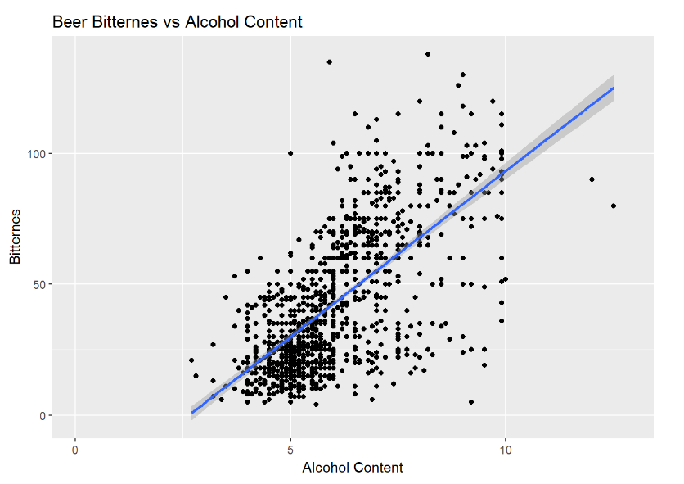
ABV versus IBU
What does the relationship show?
There is visual evidence that there is a positive linear relation between the alcohol content and the IBU values (R-Squared 0.44). For every one percent increase in ABV value, there is an increase of 12.2 units in the IBU average (pvalue < 0.001)
Beers like IPA, fall at the end of this spectrum high ABV and high IBU. Other styles like Stouts can be on the high ABV and low to medium IBU.

Slide 6
Conclusion
Dataset needs cleaning work.
  Duplicates
  Typos
  Units
Every state is different when it comes to level of alcohol in beers. The more alcohol content, the more restriction in the state.
Positive linear correlation between Alcohol content and the Bittering Units.

